Slide 1
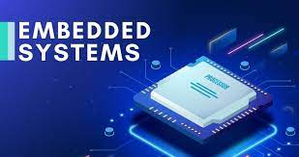
Introduction

Slide 2

UNIT-1
Introduction To Embedded System
Presented By:
P. VYASA OMKAR
Asst.Prof.ECE
Lecture Details:
Topic:Introduction To Embedded System
ESD/ECE/CSM, VII Semester.

Slide 3
Contents
Embedded system- Defination, History Of Embedded systems
Classification of Embedded systems
Major application areas of Embedded systems
Purpose of Embedded systems
The typical embedded system-core of the ES
Memory, Sensors and Actuators, Communication Interface
Embedded Firmware,

Slide 4
What is an Embedded System?
An embedded system is a combination of computer hardware and software designed for a specific function.
Generally a microcontroller or microprocessor is included as an integral part of the system

Slide 5
Microcontroller Or Microprocessor
Microcontroller
A microcontroller is a compact integrated circuit designed to govern/Rool a specific operation in an embedded system.
A typical microcontroller includes a processor, memory and input/output (I/O) peripherals on a single chip.
Microprocessor:
A microprocessor is a computer processor where the data processing logic and control is included on a single integrated circuit (IC), or a small number of ICs.

Slide 6
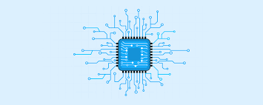
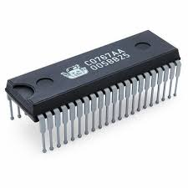
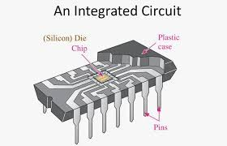
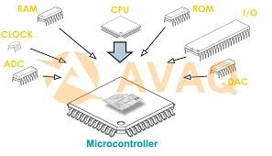
CHIP
INTEGRATED CIRCUIT

Slide 7
History of Embedded system
In 1960, embdded system was first used for developing Apollo Guidance System by Charles Stark Draper at MIT.
In 1965, Autonetics, developed the D-17B, the computer used in the Minuteman missile guidance system.
In 1968, the first embedded system for a vehicle was released.
Texas Instruments developed the first microcontroller in 1971.
In 1987, the first embedded OS, VxWorks, was released by Wind River.
Microsoft’s Windows embedded CE in 1996.
By the late 1990s, the first embedded Linux system appeared.
The embedded market reach $140 billion in 2013.
Analysts are projecting an Embedded market larger than $40 billion by 2030.

Slide 8
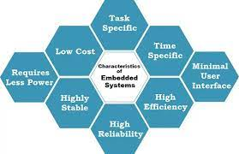
Characteristics of an Embedded System

Slide 9
Important characteristics of an embedded system
Requires real time performance
It should have high availability and reliability.
Developed around a real-time operating system
Usually, have easy and a diskless operation, ROM boot
Designed for one specific task
It must be connected with peripherals to connect input and output devices.
Offers high reliability and stability
Needed minimal user interface
Limited memory, low cost, fewer power consumptions
It does not need any secondary memory in computer.

Slide 10
Important Terminologies Used In Embedded System
Reliability:
This measure of the survival probability of the system when the function is critical during the run time.
Fault-Tolerance:
Fault-Tolerance is the capability of a computer system to survive in the presence of faults.
Real-Time:
Embedded system must meet various timing and other limitation.
For example, an air force department which keeps track of incoming missile attacks must precisely calculate and plan their counter-attack due to hard real-time deadline. Otherwise, it’ll get destroyed.

Slide 11
Flexibility:
It’s building systems with built-in debugging opportunities which allows remote maintenance.
Collect various types of data and send collected detail back to us.
Portability:
Portability is a measure of the ease of using the same embedded software in various environments.
It requires generalized abstractions between the application program logic itself and the low-level system interfaces.

Slide 12
Types of Embedded Systems
1. Based on Performance and Functional Requirements
A) Real-Time systems:
Perform a task in real-time
Offer quick responses under critical situations.
Further divided into two types of embedded systems:
B) Soft real-time embedded system:
No time-bound operation is required.
For instance, in a microwave oven,
There is no strict cooking time instruction.
You can customize time delays as per your requirement.
C) Hard real-time embedded system:
strictly time-bound operation is necessary for a successful output,
ex: traffic light control.

Slide 13
Stand-alone systems/ Network systems / Mobile systems
Stand-alone systems
Process digital/analog input signals into digital output
Less complex
Independent of any system
Ex: doorbell, calculator, MP3 player
Network systems
Operate through a network interface
Communication to network happens through LAN, WAN, or other protocols
May be wired or wireless
Ex: ATM machines, weather monitoring systems
Mobile systems
Small, portable and easy-to-carry
Work on restricted memory space
Constantly evolving to get into a miniature model
Ex: mobile phones, digital camera

Slide 14
2.Based on the Performance of the Microcontroller
Small Scale System
Entry-level embedded system with no design complexity involves
Work with 8-bit (8051) or 16-bit (80196) microcontrollers
Most of these systems are battery operated
Hardware and software complexity is very low due to the small size of microcontrollers
Easy to program using assembly language or C-programing language
Requires small memory as it deals with a small amount of data
Ex: robotic arm controller, electronic toys, automatic coffee vending machines, thermometer.

Slide 15
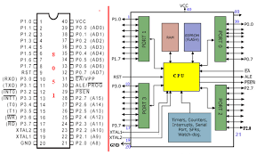
8-bit (8051)

Slide 16
3.Medium Scale System
System is designed using 16-bit or 32-bit microcontrollers
Offers better speed than small scale Embedded system
Hardware and software complexity is present
Run through Microcontrollers and digital signal processors
Requires comparatively more memory power than small scale ones
Along with microcontrollers, you need application-specific operating systems
Ex: Routers, ATMs, music systems, pagers

Slide 17
4.Sophisticated Systems
Make use of 32-bit or 64-bit microcontroller and multi-core processors
Requires very high memory power
Power consumption is the highest among rest types of embedded systems
Hardware and software complexities are enormous
Speed is a major concern
Some applications, like satellite systems, also involve real-time operating system (RTOS)
Ex: mobile systems, washing machines, digital watches, LAN cards, multimedia systems

Slide 18
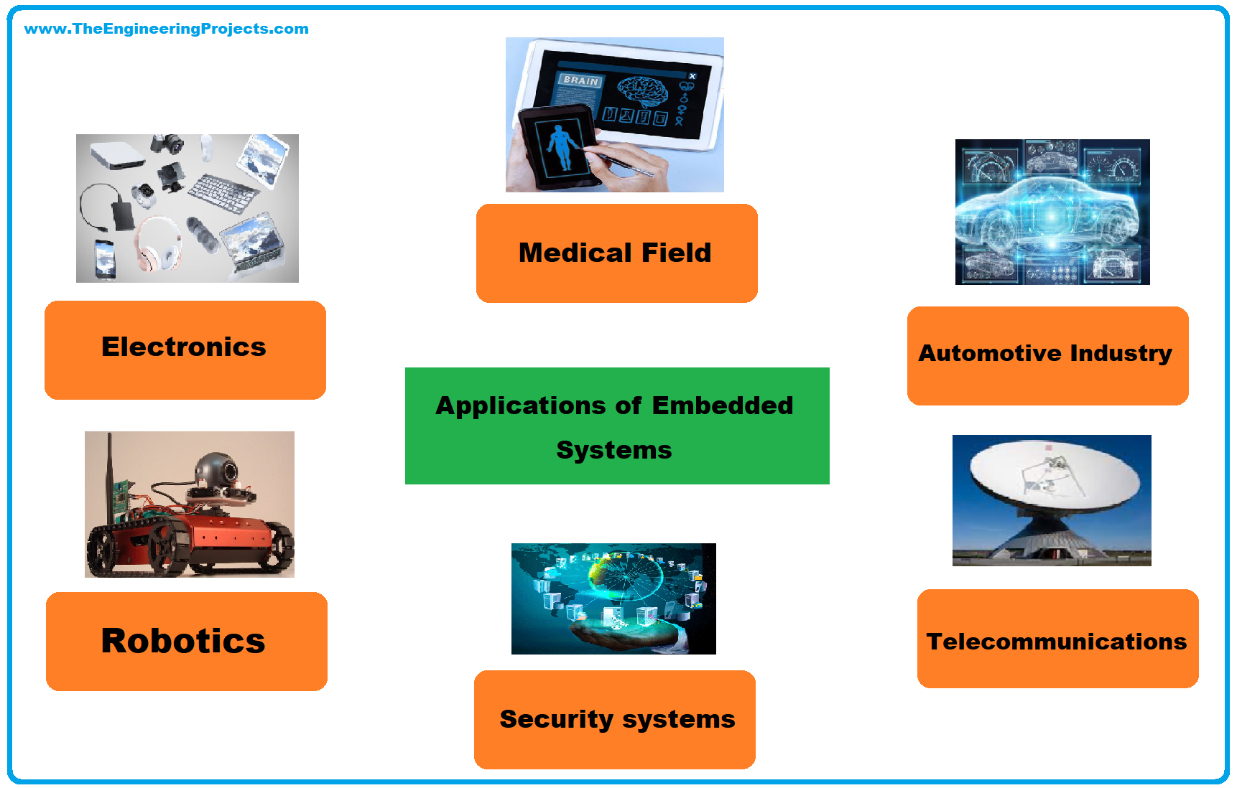
Major applications of embedded systems

Slide 19
Applications of Embedded Systems
Embedded systems can be an excellent tool for running a factory assembly line or tracking your steps.
And they can be found in every industry on the planet.
A few examples are finance,
Consumer electronics,
Automotive,
Manufacturing,
Healthcare, and many others.

Slide 20
Automotive Industry
Embedded systems help make vehicles safer, more comfortable, and good-handling.
Advanced embedded systems are also actively used in
Telematics
(The combination of information technology with telecommunications),
Emission control,
(All measures taken to reduce the amount of pollutants)
Tire pressure monitoring etc.

Slide 21
Home Appliances
Today, you need to do as much as lift your finger to get a cup of great coffee, reheat a sandwich in the micro, or set up your robot vacuum.
Charging the device, installing necessary components like the dustbin and filter, connecting it to your wi-fi network through the companion app, and potentially setting a cleaning schedule.
And they are embedded systems that help your favorite appliances do the job for you.
Embedded systems rely on microcontrollers to the speed, modes of operation, and other functions of the devices you use every day.

Slide 22
Healthcare
The role of embedded devices in healthcare is difficult to overstate.
Without embedded systems it would be impossible to look inside your body for clues about your condition.
But it’s not only the diagnostic imaging sphere that can benefit from embedded systems.
Through embedded systems, you can take your vital signs, monitor your blood pressure and glucose levels in real-time, and much more.

Slide 23
Industrial Automation
Streamlining and automating operational processes are vital for further development and growth of the manufacturing sector.
Embedded systems are often deployed in manufacturing facilities to improve
Production quality,
Automate repetitive manual processes, and
Manage machinery and equipment in a more efficient manner.

Slide 24
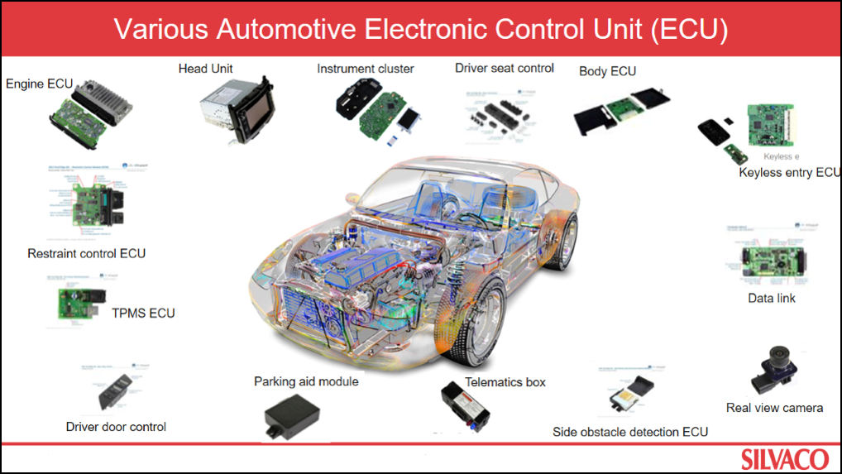
Automotive Embedded Systems.

Slide 25
Automotive Industry
Autonomous Vehicles:
Autonomous vehicles are the future of transportation and heavily rely on embedded systems.
These systems use sensors and data processing algorithms to interpret the surroundings and make decisions.
As the technology progresses, more and more sensors and algorithms will be added, making vehicles safer and more efficient.
Electric Vehicles:
Electric vehicles are gaining popularity due to their environmental benefits.
Embedded systems can play a crucial role in managing electric vehicles' battery, motor, and charging systems.
The systems can optimise power consumption, reduce battery wear, and ensure safe and efficient charging.

Slide 26
Automotive Industry
Connectivity: With the advent of 5G and the Internet of Things (IoT), automobile-embedded systems can communicate with other devices and systems.
Augmented Reality: Embedded systems can create augmented reality (AR) displays in automobiles.
These displays can provide drivers with useful real-time information such as navigation, speed, and vehicle status.
Personalisation: Embedded systems can be used to personalise the driving experience for each individual.
The systems can automatically adjust the seat position, music, temperature, and other parameters based on the driver's preferences.
Safety: Embedded systems can enhance the safety of automobiles by detecting and avoiding obstacles, monitoring driver behaviour, and alerting the driver in case of emergencies.

Slide 27
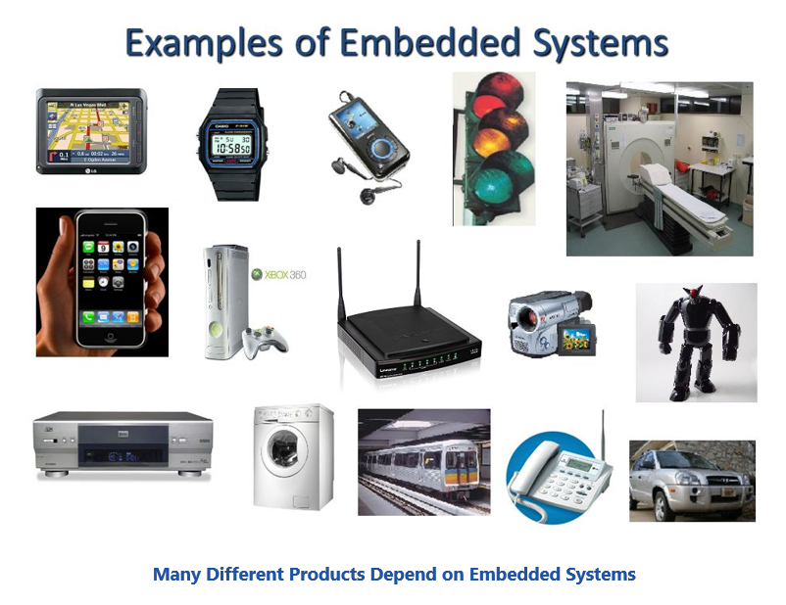
Applications of Embedded Systems

Slide 28
General Applications of Embedded Systems.
1. Consumer Electronics:
Embedded systems are used in various consumer electronics products, including smartphones, smartwatches, digital cameras, and home appliances such as refrigerators, washing machines, and air conditioners.
2. Automotive:
Embedded systems are used extensively in the automotive industry for various applications such as engine management, anti-lock braking systems (ABS), airbag control systems, and entertainment systems.
3. Medical Devices:
Embedded systems are used in medical devices such as pacemakers, insulin pumps, and blood glucose meters. These devices help in monitoring and controlling critical functions of the body.

Slide 29
General Applications of Embedded Systems..
4. Industrial Automation: Embedded systems are used in industrial automation systems, such as manufacturing plants, oil and gas refineries, and power plants. These systems help control and monitor these industries' various processes and equipment.
5. Robotics: Embedded systems are used in robotics for controlling and monitoring the movements of the robot. These systems are also used in unmanned aerial vehicles (UAVs) and unmanned ground vehicles (UGVs) for various applications.
6. Aerospace: Embedded systems are used in the aerospace industry for various applications such as flight control, navigation, and communication systems.

Slide 30
General Applications of Embedded Systems-...
7. Security Systems:
Embedded systems are used in security systems, such as surveillance cameras, access control systems, and alarm systems.
These systems help monitor and secure homes, offices, and public places.
8. Gaming:
Embedded systems are used in gaming consoles and handheld gaming devices to provide a rich gaming experience.

Slide 31
Purpose of embedded systems
The purpose of embedded systems is to control a specific function within a device.
They are usually designed to only perform this function repeatedly.
but more developed embedded systems can control entire operating systems.

Slide 32
Purpose Of Embedded System
Receiving Information Receiving information or data from various sources. and also molding and checking the compatibility of this data.
Processing information Using calculations, numerical, legitimate, and investigative methods to analyze meaning out of data, and process significant information, find out the desired conclusions, observations, and desired results.
Conveying Information Provide the outcomes, information, and so forth to the various entities which could utilize it seriously, and giving an interface to such elements.

Slide 33
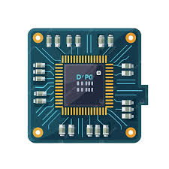
Classification Of Embedded Systems
The classification of embedded system is based on following criteria’s:
1.Based on generation
2.Based on complexity
3.Based on deterministic behaviour
4.Based on triggering
Notes:
33

Slide 34
Classification Of Embedded Systems
1.Based on generation:
A.First generation(1G):
Built around 8bit microprocessor and microcontroller.
Simple in hardware circuit and firmware developed
Firmware is a type of software program embedded into hardware devices to help them function smoothly and effectively.
Firmware is installed directly onto a piece of hardware during manufacturing.
It is used to run user programs on the device and can be thought of as the software that enables hardware to run.
Examples:Digital telephone keypads.

Slide 35
Classification Of Embedded Systems
1.Based on generation:
B.Second generation(2G):
Built around 8- and 16-bit microprocessors/microcontrollers.
more complex instruction set and powerful computing.
Some of them may use an operating system for a supervised operation.
Example: Supervisory control and data acquisition (SCADA)

Slide 36
Classification Of Embedded Systems
1.Based on generation:
C. Third generation(3G):
Built around more powerful 16- and 32-bit microprocessors & microcontrollers.
Concepts like Digital Signal Processors(DSPs)
Application Specific Integrated Circuits(ASICs) evolved.
Examples:Robotics,Media

Slide 37
Classification Of Embedded Systems
1.Based on generation:
D.Fourth generation(4G):
Built around 64-bit microprocessor and 32-bit microcontroller.
The concept of System on Chips(SoC),Multicore Processors evolved.
Highly complex and very powerful.
Examples:Smart phones.

Slide 38
2.Based on complexity
A. Small-scale
B. Medium-scale
C. Large-scale

Slide 39
Classification Of Embedded Systems
2.Based on complexity:
A.Small-scale:
Simple in application need.
Performance not time critical.
Built around low performance and low cost 8or 16bit microprocessor/microcontroller.
Examples:an electronic toy.

Slide 40
Classification Of Embedded Systems
2.Based on complexity:
B.Medium-scale:
Slightly complex in hardware & firmware requirement.
Usually contain operating system.
Built around medium performance and low cost 16 or 32bit microprocessor/microcontroller.
Examples:industrial machines.

Slide 41
Classification Of Embedded Systems
2.Based on complexity:
C.Large-scale:
Highly complex in hardware & firmware.
Built around 32 or 64 bit RISC microprocessor/microcontroller or PLDs or Multicore Processors.
Response is time critical.
Examples: mission control applications.

Slide 42
Classification Of Embedded Systems
3.Based on deterministic behaviour:
This classification is applicable for “REAL TIME” systems.
The task execution behavior for an embedded system may be deterministic or non-deterministic.
Based on execution behavior Real Time embedded system divided into hard & soft.

Slide 43
Classification Of Embedded Systems
4.Based on triggering:
Embedded Systems which are “Reactive” in nature can be based on triggering.
Reactive System can be:
a.Event triggered.
b.Time triggered.
A)Event triggered systems perform actions in response to specific events, like clicking a button or receiving data. b.) Time triggered systems execute tasks at predefined time intervals or schedules, regardless of events.

Slide 44
Purpose Of Embedded Systems
Each embedded system is designed to serve-the purpose of any one or a combination of the following tasks:
1. Data collection/Storage/Representation
2. Data communication
3. Data (signal) processing
4. Monitoring
5. Control
6. Application specific user interface.

Slide 45
Purpose Of Embedded Systems
1. Data collection/Storage/Representation:
Embedded systems designed for the purpose of data collection performs
acquisition of data from the external world.
Data collection is usually done for storage, analysis, manipulation and
transmission.
Analog and digital CROs without storage memory are typical examples of this.Any measuring equipment used in the medical domain for monitoring without storage functionality also come under this category.

Slide 46
Purpose Of Embedded Systems
1. Data collection/Storage/Representation:
A digital camera is a typical example of an embedded system with data collection/storage/representation of data.
Images are captured and the captured image may be stored within the memory of the camera.
The captured image can also be presented to the user through a graphic LCD unit.

Slide 47
Purpose Of Embedded Systems
2. Data communication:
Embedded data communication systems are deployed in applications ranging from complex satellite communication systems to simple home networking systems.
The data collected by embedded terminal may require transferring of the same to some other system located remotely.
The transmission is achieved either by a wire-line medium or by a wireless medium.

Slide 48
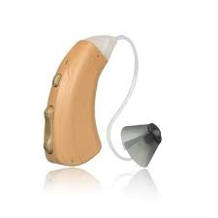
Purpose Of Embedded Systems
3. Data (signal) Processing:
Embedded systems with signal processing functionalities are employed in applications demanding signal processing like
speech coding,
synthesis, audio video codec, transmission applications, etc.
A digital hearing aid is a typical example of an embedded system employing data processing.
Digital hearing aid improves the hearing capacity of hearing impaired persons.

Slide 49
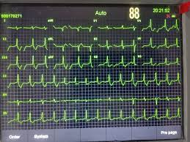
Purpose Of Embedded Systems
4. Monitoring:
They are used for determining the state of some variables using input sensors. They cannot impose control over variables.
A very good example is the electro cardiogram (ECG) machine for monitoring the heartbeat of a patient.

Slide 50
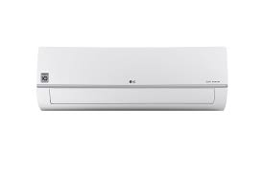
Purpose Of Embedded Systems
4. Control:
Embedded systems with control functionalities impose control over some variables according to the changes in input variables.
A system with control functionality contains both sensors and actuators..

Slide 51

Purpose Of Embedded Systems
5. Application specific user interface:
These are embedded systems with application-specific user interfaces like buttons, switches,keypad, lights, bells, display units, etc..
Mobile phone is an example for this.

Slide 52
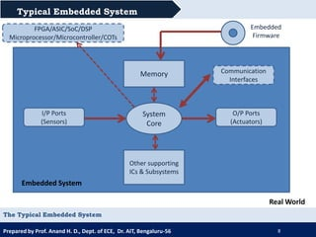
The Typical Embedded System

Slide 53
The Typical Embedded System
Core of the Embedded System:
The core of the embedded system falls into any one of the following categories:
1. General Purpose and Domain Specific Processors
1.1 Microprocessors
1.2 Microcontrollers
1.3 Digital Signal Processors
2. Application Specific Integrated Circuits (ASICs)
3. Programmable Logic Devices (PLDs)
4. Commercial off-the-shelf Components (COTS)

Slide 54
Microprocessor (MPU)
A microprocessor is a general-purpose digital computing
processor on a single integrated circuit (IC) that performs arithmetic and logic operations.
Key Features:
Central Processing Unit (CPU) only (no built-in RAM, ROM, or I/O ports)
Needs external components for memory and I/O
Designed for complex and multitasking systems (like PCs)
Applications:
Computers (laptops, desktops),Servers,Industrial automation
Example: Intel i7, AMD Ryzen, etc.

Slide 55
Microcontroller (MCU)
A microcontroller is a compact integrated circuit designed for specific control applications.
It includes a CPU + memory (RAM/ROM) + I/O ports on one chip.
Features:
All-in-one system: processor, memory, and peripherals
Low cost, low power
Designed for dedicated embedded applications
Applications:
Home appliances (microwaves, washing machines)
Automotive (engine control units)
IoT devices
Robotics
Example: ATmega328 (Arduino), STM32, PIC16F877A

Slide 56
Digital Signal Processor (DSP)
A DSP is a specialized microprocessor designed
specifically for high-speed numeric processing of signals like audio, video, and sensor data.
Features:
Optimized for real-time signal processing
Supports fast multiply-accumulate operations (MAC)
Pipelined architecture for speed
Applications:
Audio and speech processing (e.g., hearing aids, sound systems)
Image and video compression (e.g., cameras)
Radar and medical signal processing
Communication systems (modems, 5G)

Slide 57
Feature | Microprocessor (MPU) | Microcontroller (MCU) | Digital Signal Processor (DSP)
Primary Use | General-purpose computing | Dedicated control applications | High-speed signal processing
Components | CPU only | CPU + RAM + ROM + I/O (all-in-one) | CPU + MAC units + RAM + I/O (Multiply-Accumulate Unit)
Speed (for computation) | High | Moderate | Very High (optimized for math operations)
Power Consumption | High | Low | Moderate
Cost | High | Low | Medium to High
Programming Complexity | Complex (OS-based) | Simple (bare-metal or RTOS) | Moderate to High (real-time constraints)

Slide 58
Memory Type | External RAM/ROM | Internal RAM/ROM | Mostly internal with fast access
Data Handling | General data processing | Simple data control | Continuous data streams (audio, video, etc.)
Architecture | CISC or RISC | Usually RISC | Highly parallel, pipelined
Example Devices | Intel i7, AMD Ryzen | ATmega328, STM32, PIC16 | TI TMS320, AD Blackfin
Common Applications | Laptops, PCs, Servers | IoT devices, appliances, robotics | Audio filters, image processing, modems
Real-Time Processing | Not optimized | Basic real-time capability | Strong real-time capabilities

Slide 59
Application Specific Integrated Circuits (ASICs)
An ASIC is a type of integrated circuit (IC) that is custom-designed for a specific application or task, rather than for general-purpose use. Advantages:
Extremely fast and efficient for specific tasks
Lower power consumption
Smaller physical size (compact)

Slide 60
Programmable Logic Devices (PLDs)
A Programmable Logic Device (PLD) is a type of digital electronic component that can be programmed by the user to perform a wide variety of logic functions.
Unlike fixed-function logic ICs (like 7400 series), PLDs are flexible and reconfigurable.
Advantages:
Flexible design (no need for fixed ICs)
Reduces development time and cost
Allows in-field reprogramming (especially FPGAs)

Slide 61
Commercial off-the-shelf Components (COTS)
Pre-manufactured hardware or software components that are mass-produced and can be purchased and used immediately without customization.
“Off-the-shelf” means you can buy it like a product in a store, as opposed to designing or building it
Advantages:
Cost-effective – No need to develop from scratch
Faster Time to Market – Speeds up development and prototyping
Tested & Reliable – Often well-documented and proven in real-world use
Easy Integration – Common standards improve compatibility

Slide 62
Memory
Memory in embedded systems refers to storage elements used to store data, instructions, or both either temporarily (like RAM) or permanently (like ROM).
Memory is critical in embedded systems for:
Storing the program (firmware)
Holding variables and temporary data
Supporting real-time execution
Type | Subtypes | Function
Primary Memory | RAM, ROM, Cache | Directly accessed by the CPU
Secondary Memory | SD Cards, Flash Drives | Used for long-term or external storage

Slide 63
Data
The actual information being used or processed.
Examples:
Numbers typed by the user
Sensor readings in an embedded system
Results of calculations
2. Instructions
Commands or program code that tells the CPU what to do.
Examples:
Add two numbers
Display a message
Store a value

Slide 64
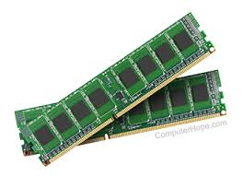
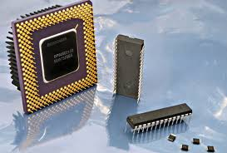
RAM- ROM
RAM (Random Access Memory) is a temporary storage for data actively being used by the computer, while ROM (Read-Only Memory) stores permanent data, like the computer's firmware, that is not frequently changed.

Slide 65
Data
The actual information being used or processed.
Examples:
Numbers typed by the user
Sensor readings in an embedded system
Results of calculations
2. Instructions
Commands or program code that tells the CPU what to do.
Examples:
Add two numbers
Display a message
Store a value

Slide 66
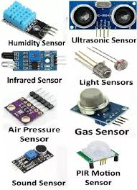
Sensors
A sensor is a device that detects and measures physical or environmental changes (such as temperature, motion, or light) and converts them into electrical signals for processing in embedded systems.

Slide 67

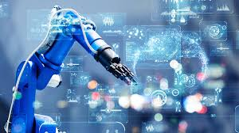
APPLICATIONS OF SENSORS
1. Medical and Healthcare
Heart rate monitors
Blood pressure sensors
Glucose monitoring
Body temperature sensors
Oxygen level (SpO2) sensors
2. Industrial Automation
Temperature sensors in machines
Proximity sensors in robotics
Pressure and flow sensors in pipelines
Gas and smoke detectors
Vibration and strain sensors

Slide 68
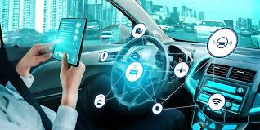
3. Automobiles and Transportation
Parking sensors (ultrasonic)
Airbag sensors (accelerometers)
Fuel level sensors
Tyre pressure monitoring
Engine temperature sensors
4. Consumer Electronics
Smartphones: touch sensors, accelerometers, gyroscope
Smart watches: fitness tracking sensors
Home appliances: temperature and humidity sensors in ACs and refrigerators

Slide 69
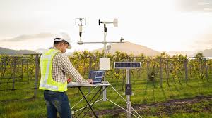
5. Environmental Monitoring
Weather stations:
humidity, temperature,
wind sensors
Air and water quality sensors
Soil moisture sensors in agriculture
Radiation sensors
6. Smart Homes / IoT
Motion sensors for security
Light sensors for smart lighting
Smoke and gas leak detectors
Voice-activated assistants (sound sensors)

Slide 70
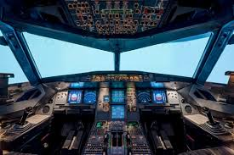
7. Aerospace and Defence
Altitude sensors
Speed and pressure sensors in aircraft
Missile guidance (inertial sensors)
Radar and sonar systems
8. Agriculture
Soil pH and moisture sensors
Climate monitoring sensors
Crop health sensors using drones

Slide 71
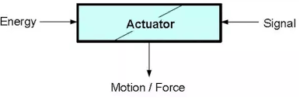
ACTUATORS
An actuator is a device that converts a signal (electrical, pneumatic, hydraulic, etc.) into mechanical motion or force.
It's essentially a component that makes things move or exert force in response to a control signal.
An actuator is a device that converts a signal (electrical, pneumatic, hydraulic, etc.) into mechanical motion or force.
It's essentially a component that makes things move or exert force in response to a control signal.

Slide 72
COMMUNICATION INTERFACING
Definition: Communication interfacing in embedded systems refers to the method by which an embedded device exchanges data with other systems, devices, sensors, or peripherals.
This is achieved through various hardware and software interfaces, enabling efficient data transfer.

Slide 73
Types of Communication Interfaces
1. Serial Communication Interfaces
2. Parallel Communication Interfaces
3. Wireless Communication Interfaces
4. USB (Universal Serial Bus)
5. CAN (Controller Area Network)
6. Ethernet

Slide 74
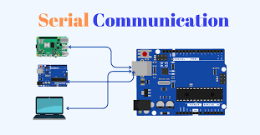
Types of Communication Interfaces
1. Serial Communication Interfaces
Transmit data bit-by-bit over a single channel.
Common types:
UART (Universal Asynchronous Receiver/Transmitter): Simple, asynchronous; used in serial ports.
USART (Universal Synchronous/Asynchronous Receiver/Transmitter): Supports synchronous and asynchronous modes.
SPI (Serial Peripheral Interface): Full-duplex; used for short-distance, high-speed communication.
I2C (Inter-Integrated Circuit): Two-wire interface; supports multiple masters/slaves.

Slide 75
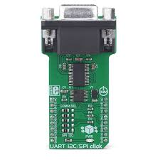
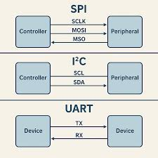

Slide 76
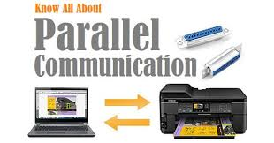
2. Parallel Communication Interfaces
Transmit multiple bits simultaneously over multiple wires.
Used in: Older systems like printers, LCDs, memory devices.
Faster but more hardware-intensive compared to serial communication.

Slide 77
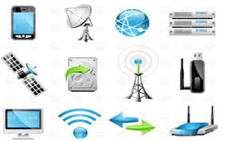
3. Wireless Communication Interfaces
Enable communication without physical connections.
Examples:
Bluetooth – Short-range device connectivity.
Wi-Fi – Internet connectivity and networking.
Zigbee / LoRa / RF modules – Low-power IoT communication.
Infrared (IR) – Short-range, line-of-sight communication.

Slide 78
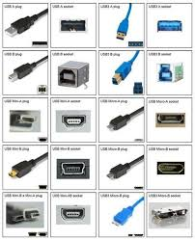
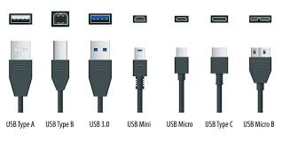
4. USB (Universal Serial Bus)
Widely used for communication between embedded systems and computers or peripherals.
Plug-and-play, hot-swappable, supports different data transfer speeds.

Slide 79
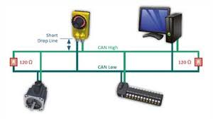
5. CAN (Controller Area Network)
Used in automotive and industrial applications.
Enables microcontrollers to communicate without a host computer.
Robust, real-time, multi-master communication.

Slide 80
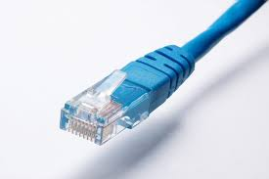
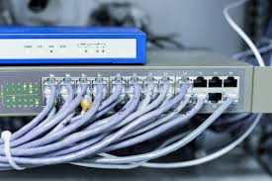
6. Ethernet
Wired network interface for high-speed data communication.
Used in embedded systems requiring internet or LAN access.

Slide 81
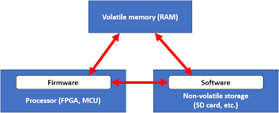
Embedded firmware

Slide 82
Embedded firmware
Definition: Embedded firmware is a specialized software programmed into non-volatile memory (such as ROM, Flash, or EEPROM) of embedded systems.
It provides low-level control for the device’s specific hardware and allows the system to function as intended.

Slide 83
Components of Embedded Firmware
Bootloader:
specialized software that controls the hardware of embedded systems
Initializes hardware and loads the main application.
Supports firmware updates.

Slide 84
Device Drivers:
Interface code between hardware peripherals and application software.
Examples: UART, SPI, GPIO drivers.
UART - Universal Asynchronous Receiver/Transmitter
SPI - serial communication protocols used in embedded systems for short-distance,
GPIO - communicate to the CPU the ON/OFF signals received from switches, or the digital readings received from sensors.

Slide 85
Real-Time Operating System (RTOS) [optional]:
Manages task scheduling, inter-task communication, and timing.
Used when multitasking is required.
Middleware:
Software libraries
(e.g., Transmission Control Protocol (TCP)/ Integrated Circuit (IP stack), file system, USB stack).
A set of communication protocols that govern how devices exchange data over the internet.
Application Code:
Implements the specific functionality or logic of the embedded device.

